Slide 1
Meiosis and Sexual Life Cycles
Chapter 13

Slide 2
Overview: Variations on a Theme
Living organisms are distinguished by their ability to reproduce their own kind.
Genetics: is the scientific study of heredity and variation
Heredity: is the transmission of traits from one generation to the next
Variation: is demonstrated by the differences in appearance that offspring show from parents and siblings

Slide 3
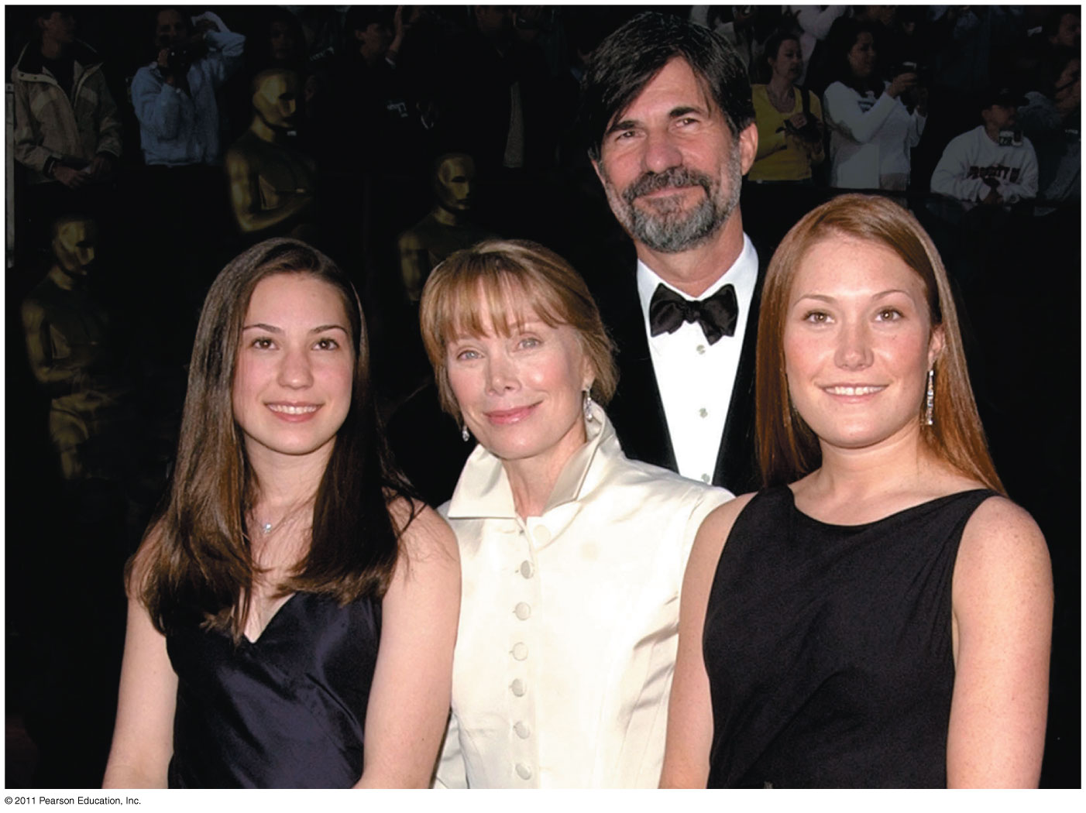
What accounts for family resemblance?

Slide 4
Offspring acquire genes from parents by inheriting chromosomes
In a literal sense, children do not inherit particular physical traits from their parents
It is genes that are actually inherited

Slide 5
Inheritance of Genes
Genes are the units of heredity, and are made up of segments of DNA
Genes are passed to the next generation via reproductive cells called gametes (sperm and eggs)
Each gene has a specific location called a locus on a certain chromosome
Most DNA is packaged into chromosomes

Slide 6
Comparison of Asexual and Sexual Reproduction
In asexual reproduction, a single individual passes genes to its offspring without the fusion of gametes
In sexual reproduction, two parents give rise to offspring that have unique combinations of genes inherited from the two parents

Slide 7
Fertilization and meiosis alternate in sexual life cycles
A life cycle is the generation-to-generation sequence of stages in the reproductive history of an organism, from conception to production of its own offspring.

Slide 8
Sets of Chromosomes in Human Cells
Human somatic cells (any cell other than a gamete) have 23 pairs of chromosomes
A karyotype is an ordered display of the pairs of chromosomes from a cell
The two chromosomes in each pair are called homologous chromosomes, or homologs
Chromosomes in a homologous pair are the same length and shape and carry genes controlling the same inherited characters

Slide 9
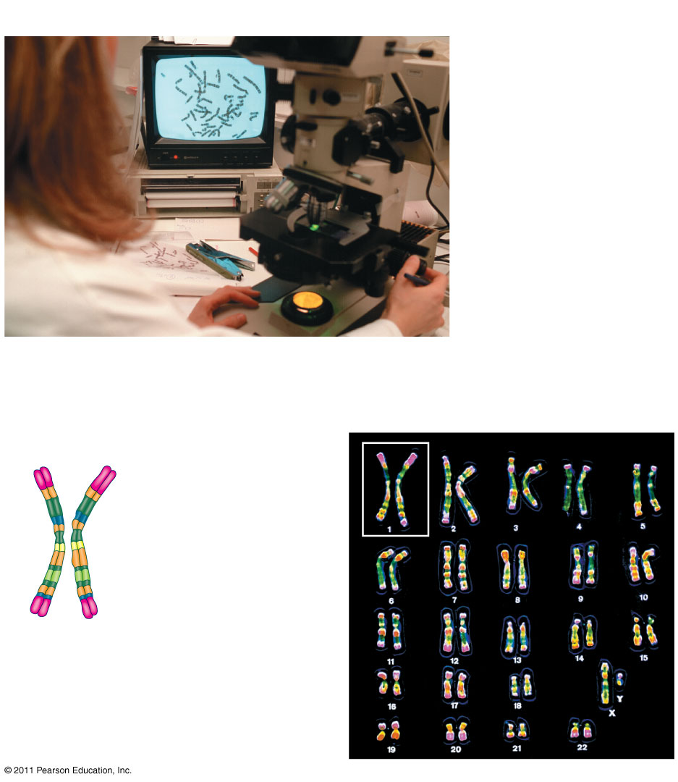
Preparing a Karyotype
APPLICATION
TECHNIQUE
Pair of homologous
duplicated chromosomes

Slide 10
Sets of Chromosomes in Human Cells
The sex chromosomes, which determine the sex of the individual, are called X and Y
Human females have a homologous pair of X chromosomes (XX)
Human males have one X and one Y chromosome
The remaining 22 pairs of chromosomes are called autosomes

Slide 11
Sets of Chromosomes in Human Cells
Each pair of homologous chromosomes includes one chromosome from each parent
The 46 chromosomes in a human somatic cell are two sets of 23: one from the mother and one from the father
A diploid cell (2n) has two sets of chromosomes
For humans, the diploid number is 46 (2n = 46)

Slide 12
Sets of Chromosomes in Human Cells
In a cell in which DNA synthesis has occurred, each chromosome is replicated
Each replicated chromosome consists of two identical sister chromatids

Slide 13
Sets of Chromosomes in Human Cells
A gamete (sperm or egg) contains a single set of chromosomes, and is haploid (n)
For humans, the haploid number is 23 (n = 23)
Each set of 23 consists of 22 autosomes and a single sex chromosome
In an unfertilized egg (ovum), the sex chromosome is X
In a sperm cell, the sex chromosome may be either X or Y

Slide 14
Behavior of Chromosome Sets in the Human Life Cycle
Fertilization is the union of gametes (the sperm and the egg)
The fertilized egg is called a zygote and has one set of chromosomes from each parent
The zygote produces somatic cells by mitosis and develops into an adult

Slide 15
Behavior of Chromosome Sets in the Human Life Cycle
At sexual maturity, the ovaries and testes produce haploid gametes
Gametes are the only types of human cells produced by meiosis, rather than mitosis
Meiosis results in one set of chromosomes in each gamete

Slide 16
The Variety of Sexual Life Cycles
The alternation of meiosis and fertilization is common to all organisms that reproduce sexually
The three main types of sexual life cycles differ in the timing of meiosis and fertilization

Slide 17
Behavior of Chromosome Sets in the Human Life Cycle
Gametes are the only haploid cells in animals
They are produces by meiosis and undergo no further cell division before fertilization
Gametes fuse to form a diploid zygote that divides by mitosis to develop into a multicellular organism

Slide 18
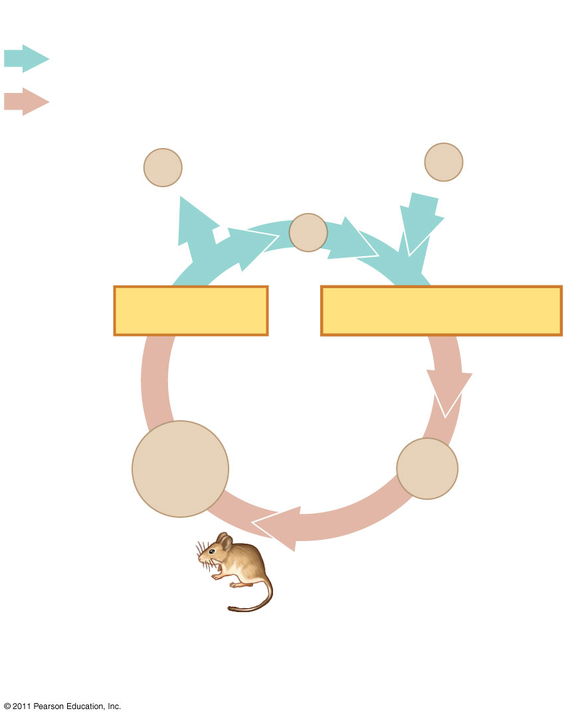
types of sexual life cycles
Key
Haploid (n)
Diploid (2n)
Gametes
n
n
MEIOSIS
FERTILIZATION
Diploid
multicellular
organism
2n
2n
Mitosis
Animals

Slide 19
Meiosis reduces the number of chromosome sets from diploid to haploid
Like mitosis, meiosis is preceded by the replication of chromosomes
Meiosis takes place in two sets of cell divisions, called meiosis I and meiosis II
The two cell divisions result in four daughter cells, rather than the two daughter cells in mitosis
Each daughter cell has only half as many chromosomes as the parent cell

Slide 20
The Stages of Meiosis
After chromosomes duplicate, two divisions follow
  Meiosis I (reductional division): homologs pair up and separate, resulting in two haploid daughter cells with replicated chromosomes
  Meiosis II (equational division) sister chromatids separate
The result is four haploid daughter cells with unreplicated chromosomes

Slide 21
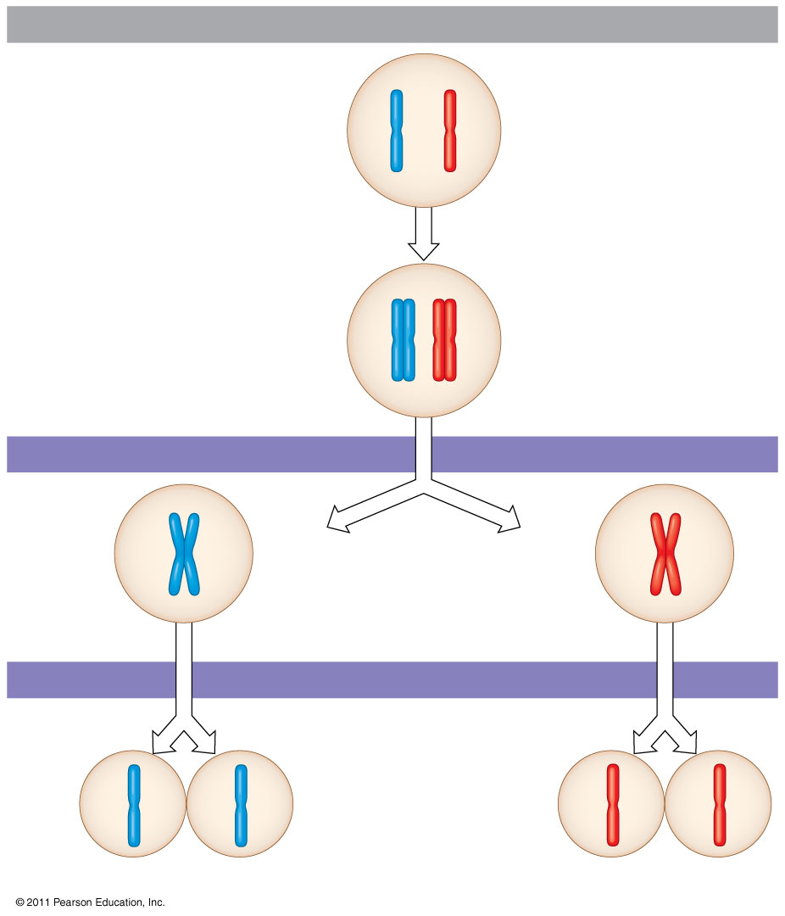
Overview of meiosis: how meiosis reduces chromosome number
Interphase
Pair of homologous
chromosomes in
diploid parent cell
Chromosomes
duplicate
Duplicated pair
of homologous
chromosomes
Meiosis I
Haploid cells with
duplicated chromosomes
Homologous
chromosomes separate
Meiosis II
Sister chromatids
separate
Haploid cells with unduplicated chromosomes

Slide 22
Overview of meiosis: how meiosis reduces chromosome number
Division in meiosis I occurs in four phases
  Prophase I
  Metaphase I
  Anaphase I
  Telophase I and cytokinesis

Slide 23
Overview of meiosis: how meiosis reduces chromosome number
Prophase I
Prophase I typically occupies more than 90% of the time required for meiosis
Chromosomes begin to condense
In synapsis, homologous chromosomes loosely pair up, aligned gene by gene

Slide 24
Overview of meiosis: how meiosis reduces chromosome number
In crossing over, nonsister chromatids exchange DNA segments
Each pair of chromosomes forms a tetrad, a group of four chromatids
Each tetrad usually has one or more chiasmata, X-shaped regions where crossing over occurred

Slide 25
Overview of meiosis: how meiosis reduces chromosome number
Metaphase I
In metaphase I, tetrads line up at the metaphase plate, with one chromosome facing each pole
Microtubules from one pole are attached to the kinetochore of one chromosome of each tetrad
Microtubules from the other pole are attached to the kinetochore of the other chromosome

Slide 26
Overview of meiosis: how meiosis reduces chromosome number
Anaphase I
In anaphase I, pairs of homologous chromosomes separate
One chromosome moves toward each pole, guided by the spindle apparatus
Sister chromatids remain attached at the centromere and move as one unit toward the pole

Slide 27
Overview of meiosis: how meiosis reduces chromosome number
Telophase I and Cytokinesis
In the beginning of telophase I, each half of the cell has a haploid set of chromosomes; each chromosome still consists of two sister chromatids
Cytokinesis usually occurs simultaneously, forming two haploid daughter cells

Slide 28
Overview of meiosis: how meiosis reduces chromosome number
In animal cells, a cleavage furrow forms; in plant cells, a cell plate forms
No chromosome replication occurs between the end of meiosis I and the beginning of meiosis II because the chromosomes are already replicated

Slide 29
Overview of meiosis: how meiosis reduces chromosome number
Division in meiosis II also occurs in four phases
  Prophase II
  Metaphase II
  Anaphase II
  Telophase II and cytokinesis
Meiosis II is very similar to mitosis

Slide 30
Overview of meiosis: how meiosis reduces chromosome number
Prophase II
In prophase II, a spindle apparatus forms
In late prophase II, chromosomes (each still composed of two chromatids) move toward the metaphase plate

Slide 31
Overview of meiosis: how meiosis reduces chromosome number
Metaphase II
In metaphase II, the sister chromatids are arranged at the metaphase plate
Because of crossing over in meiosis I, the two sister chromatids of each chromosome are no longer genetically identical
The kinetochores of sister chromatids attach to microtubules extending from opposite poles

Slide 32
Overview of meiosis: how meiosis reduces chromosome number
Anaphase II
In anaphase II, the sister chromatids separate
The sister chromatids of each chromosome now move as two newly individual chromosomes toward opposite poles

Slide 33
Overview of meiosis: how meiosis reduces chromosome number
Telophase II and Cytokinesis
In telophase II, the chromosomes arrive at opposite poles
Nuclei form, and the chromosomes begin decondensing

Slide 34
Overview of meiosis: how meiosis reduces chromosome number
Cytokinesis separates the cytoplasm
At the end of meiosis, there are four daughter cells, each with a haploid set of unreplicated chromosomes
Each daughter cell is genetically distinct from the others and from the parent cell

Slide 35
A Comparison of Mitosis and Meiosis
Mitosis conserves the number of chromosome sets, producing cells that are genetically identical to the parent cell
Meiosis reduces the number of chromosomes sets from two (diploid) to one (haploid), producing cells that differ genetically from each other and from the parent cell

Slide 36
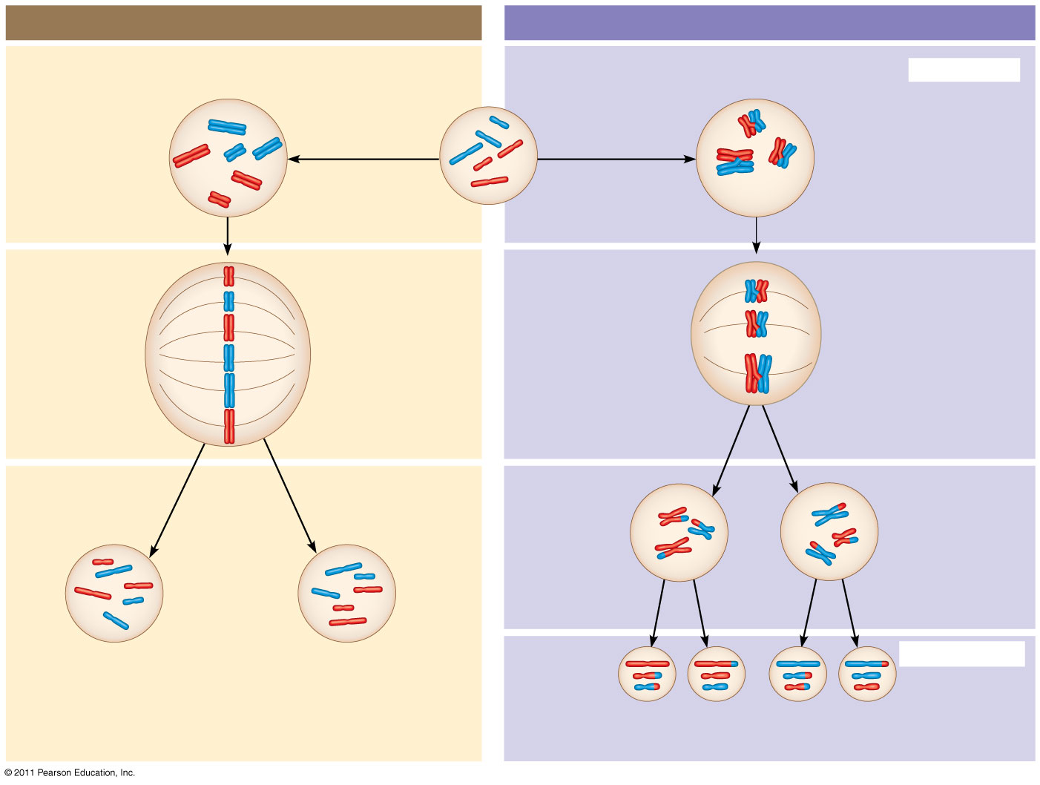
A comparison of mitosis and meiosis in diploid cells
MITOSIS
MEIOSis
Prophase
Parent cell
MEIOSIS I
Chromosome
duplication
Chromosome
duplication
2n = 6
Metaphase
Metaphase I
Anaphase I
Telophase
Daughter
cells of
meiosis I
Anaphase
Telophase
Haploid
n = 3
2n
MEIOSIS II
2n
n
n
n
n

Slide 37
A comparison of mitosis and meiosis in diploid cells
Three events are unique to meiosis, and all three occur in meiosis l
  Synapsis and crossing over in prophase I: Homologous chromosomes physically connect and exchange genetic information
  At the metaphase plate, there are paired homologous chromosomes (tetrads), instead of individual replicated chromosomes
  At anaphase I, it is homologous chromosomes, instead of sister chromatids, that separate

Slide 38
Genetic variation produced in sexual life cycles contributes to evolution
Mutations (changes in an organism’s DNA) are the original source of genetic diversity
Mutations create different versions of genes called alleles
Reshuffling of alleles during sexual reproduction produces genetic variation

Slide 39
Genetic variation produced in sexual life cycles contributes to evolution
The behavior of chromosomes during meiosis and fertilization is responsible for most of the variation that arises in each generation
Three mechanisms contribute to genetic variation
  Independent assortment of chromosomes
  Crossing over
  Random fertilization

Slide 40
Independent Assortment of Chromosomes
Homologous pairs of chromosomes orient randomly at metaphase I of meiosis
In independent assortment, each pair of chromosomes sorts maternal and paternal homologs into daughter cells independently of the other pairs

Slide 41
Independent Assortment of Chromosomes
The number of combinations possible when chromosomes assort independently into gametes is 2^{n}, where n is the haploid number
For humans (n = 23), there are more than 8 million (2²³) possible combinations of chromosomes

Slide 42
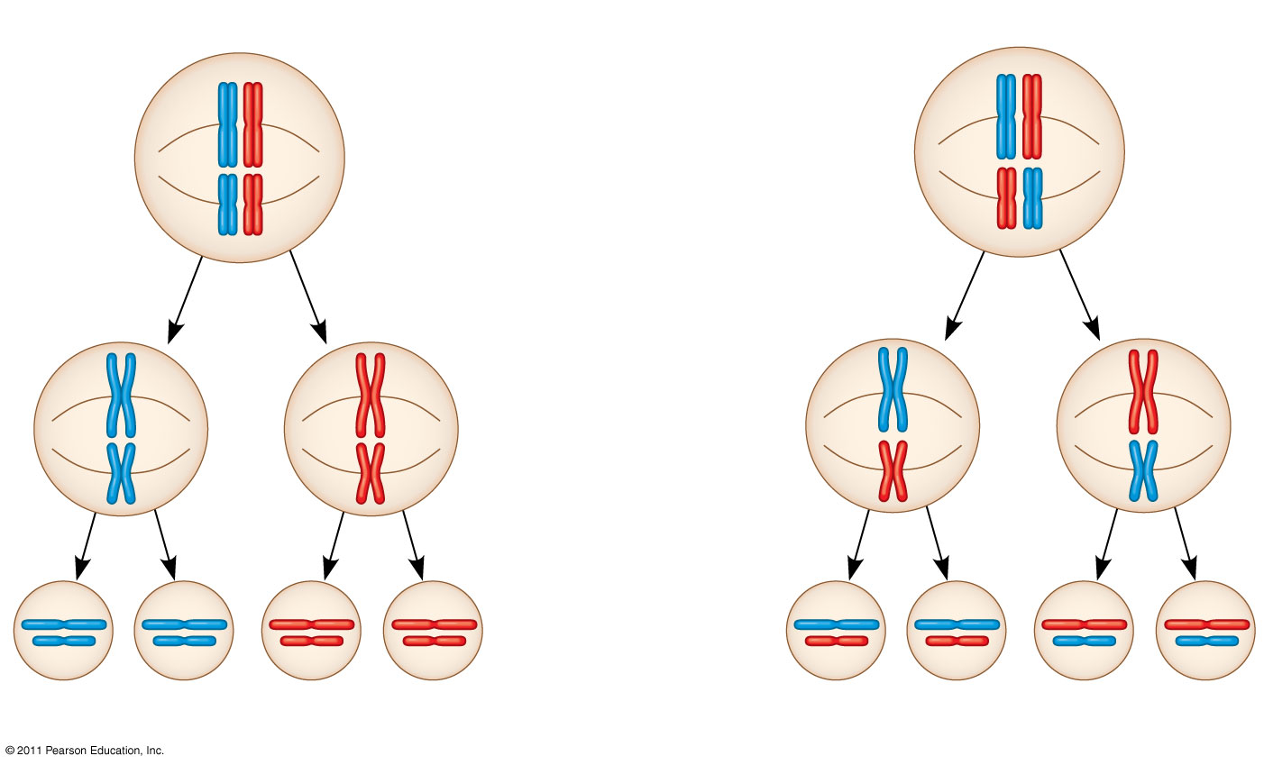
Independent Assortment of Chromosomes
Possibility 1
Possibility 2
Two equally probable
arrangements of
chromosomes at
metaphase I
Metaphase II
Daughter
cells
Combination 1
Combination 2
Combination 3
Combination 4

Slide 43
Crossing Over
Crossing over produces recombinant chromosomes, which combine DNA inherited from each parent
Crossing over begins very early in prophase I, as homologous chromosomes pair up gene by gene

Slide 44
Crossing Over
In crossing over, homologous portions of two nonsister chromatids trade places
Crossing over contributes to genetic variation by combining DNA from two parents into a single chromosome

Slide 45
Random Fertilization
Random fertilization adds to genetic variation because any sperm can fuse with any ovum (unfertilized egg)
The fusion of two gametes (each with 8.4 million possible chromosome combinations from independent assortment) produces a zygote with any of about 70 trillion diploid combinations

Slide 46
The Evolutionary Significance of Genetic Variation Within Populations
Natural selection results in the accumulation of genetic variations favored by the environment
Sexual reproduction contributes to the genetic variation in a population, which originates from mutations

